Slide 1
Lecture 2: Binary Classification
Kai-Wei Chang
CS @ UCLA
kw@kwchang.net
Couse webpage: https://uclanlp.github.io/CS269-17/

Slide 2
Announcements
Waiting list: If you’re not enrolled, please sign up.
We will use Piazza as an online discussion platform. Please sign up here: piazza.com/ucla/fall2017/cs269

Slide 3
This Lecture
Supervised Learning
Linear Classifiers
Perceptron Algorithm
Support Vector Machine
Logistic Regression
Optimization in machine learning

Slide 4
The Badges game
Conference attendees to the ICML 1994 were given name badges labeled with + or −.
What function was used to assign these labels?
+ Naoki Abe
- Eric Baum

Slide 5
Training data
+ Naoki Abe
- Myriam Abramson
+ David W. Aha
+ Kamal M. Ali
- Eric Allender
+ Dana Angluin
- Chidanand Apte
+ Minoru Asada
+ Lars Asker
+ Javed Aslam
+ Jose L. Balcazar
- Cristina Baroglio
+ Peter Bartlett
- Eric Baum
+ Welton Becket
- Shai Ben-David
+ George Berg
+ Neil Berkman
+ Malini Bhandaru
+ Bir Bhanu
+ Reinhard Blasig
- Avrim Blum
- Anselm Blumer
+ Justin Boyan
+ Carla E. Brodley
+ Nader Bshouty
- Wray Buntine
- Andrey Burago
+ Tom Bylander
+ Bill Byrne
- Claire Cardie
+ John Case
+ Jason Catlett
- Philip Chan
- Zhixiang Chen
- Chris Darken

Slide 6
Raw test data
Gerald F. DeJong
Chris Drummond
Yolanda Gil
Attilio Giordana
Jiarong Hong
J. R. Quinlan
Priscilla Rasmussen
Dan Roth
Yoram Singer
Lyle H. Ungar

Slide 7
Why we need machine learning?
There is no (or limited numbers of) human expert for some problems
E.g.: Identify DNA binding sites, predicting disease progression, predicting protein folding structure

Slide 8
Why we need machine learning?
There is no (or limited numbers of) human expert for some problems
Humans can perform a task, but can’t describe how they do it
E.g.: Object recognition
?

Slide 9
Why we need machine learning?
There is no (or limited numbers of) human expert for some problems
Humans can perform a task, but can’t describe how they do it
The desired function is hard to be written down in a closed form
E.g.,: predict stock price

Slide 10
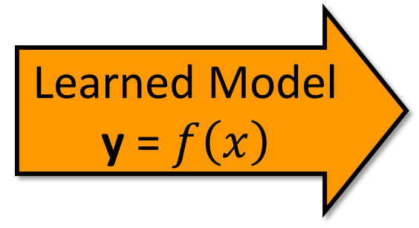
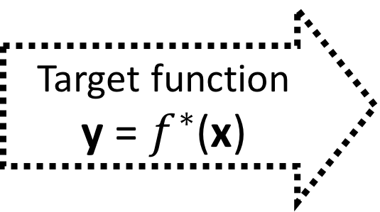
Supervised learning
Input
x∈ X
An item x drawn from an instance space X
Target function
y = $f^{∗}$(x)
Output
y∈ Y
An item y drawn from a label space Y
Learned Model y = $f\left(x\right)$

Slide 11
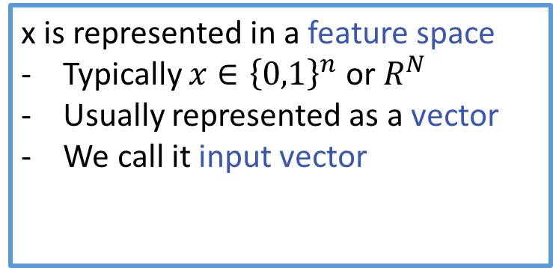
Supervised learning
Input
x∈ X
An item x drawn from an instance space X
x is represented in a feature space
Typically $x∈{\left\{0,1\right\}}^{n}$ or $R^{N}$
Usually represented as a vector
We call it input vector

Slide 12
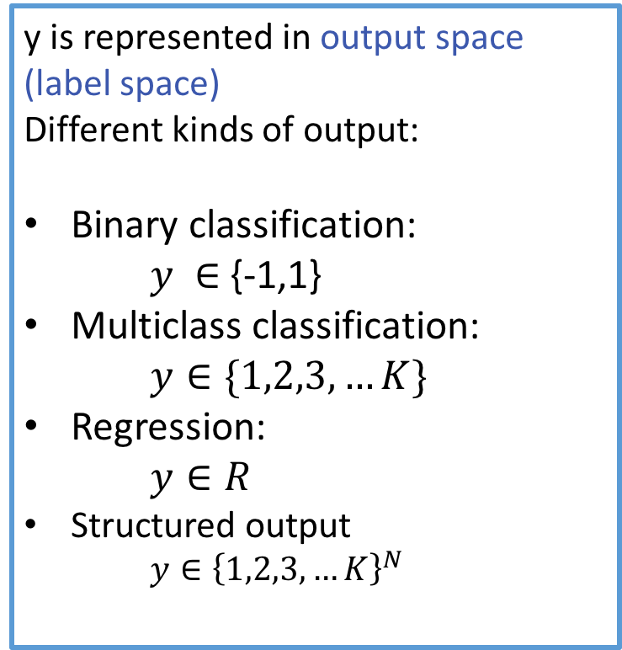
Supervised learning
y is represented in output space (label space)
Different kinds of output:
Binary classification: $y ∈$ {-1,1}
Multiclass classification: $y∈\{1,2,3,…K\}$
Regression: $y∈R$
Structured output $y∈{\left\{1,2,3,…K\right\}}^{N}$
Output
y∈ Y
An item y drawn from a label space Y

Slide 13
Learning the mapping
Input
x∈ X
An item x drawn from an instance space X
Target function
y = $f^{∗}$(x)
Output
y∈ Y
An item y drawn from a label space Y
Learned Model y = $f\left(x\right)$

Slide 14
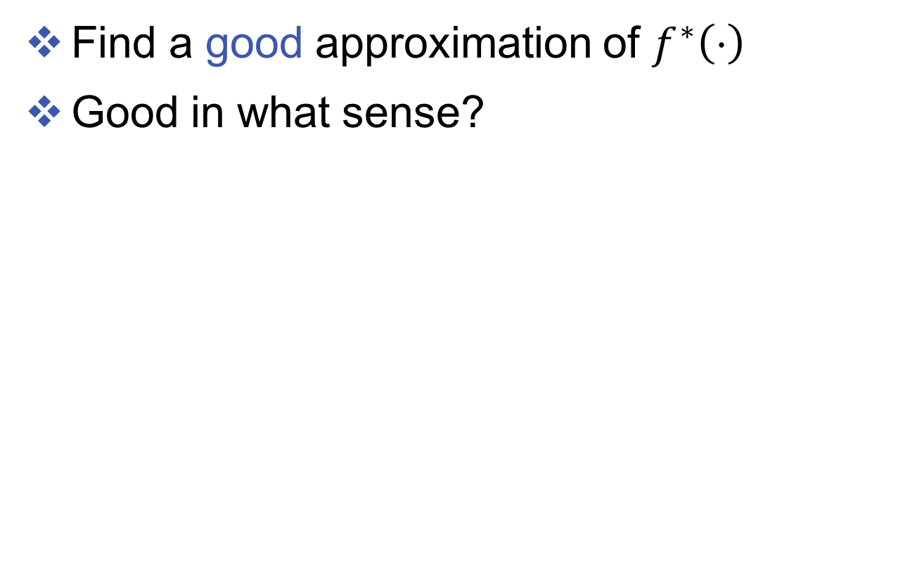
Goal
Find a good approximation of $f^{∗}\left(⋅\right)$
Good in what sense?

Slide 15
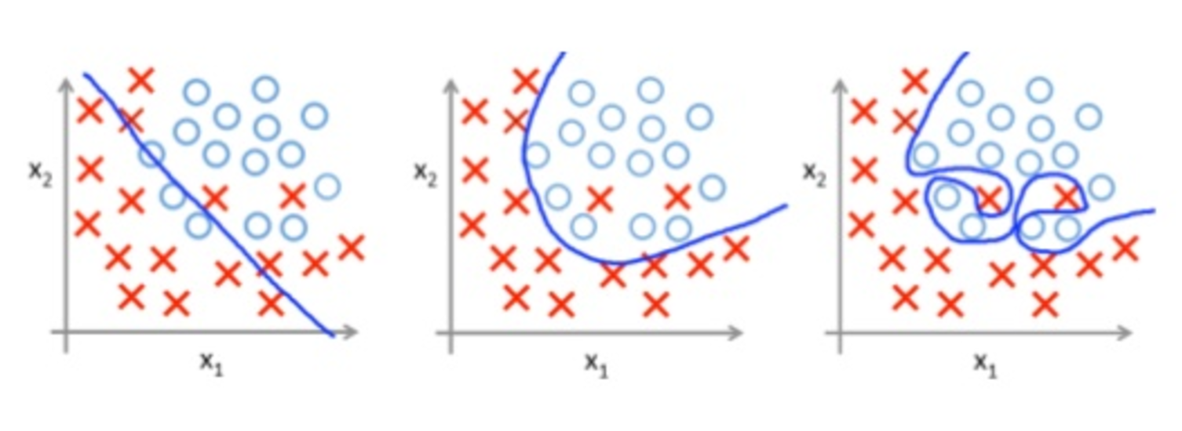
Under-fitting and over-fitting
Which classifier (blue line) is the best one?

Slide 16
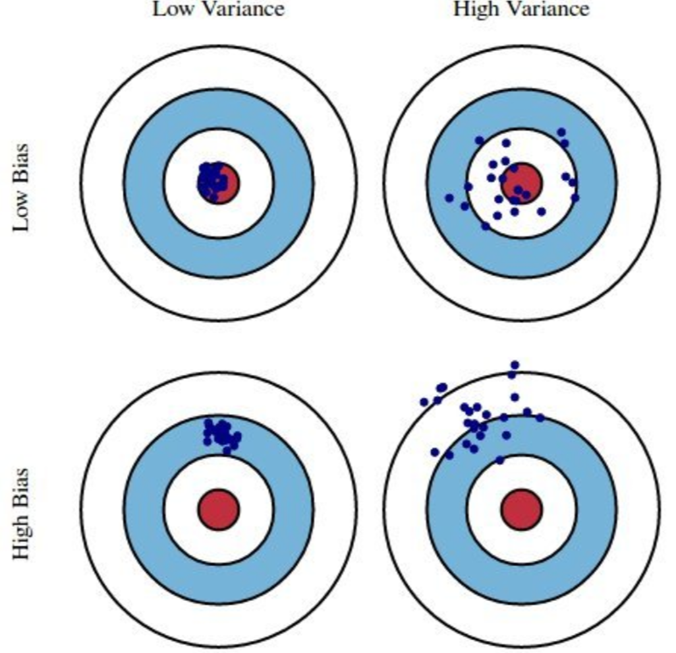
Bias V.S. Variance
Remember, training data are subsamples drawn from the true distribution
Exam strategy:
Study every chapter well
A+: Low var & bias
Study only a few chapters
A+? B? C? Low bias; High var
Study every chapter roughly
B+: Low var; high bias
Go to sleep
B ~D: High var, high bias

Slide 17
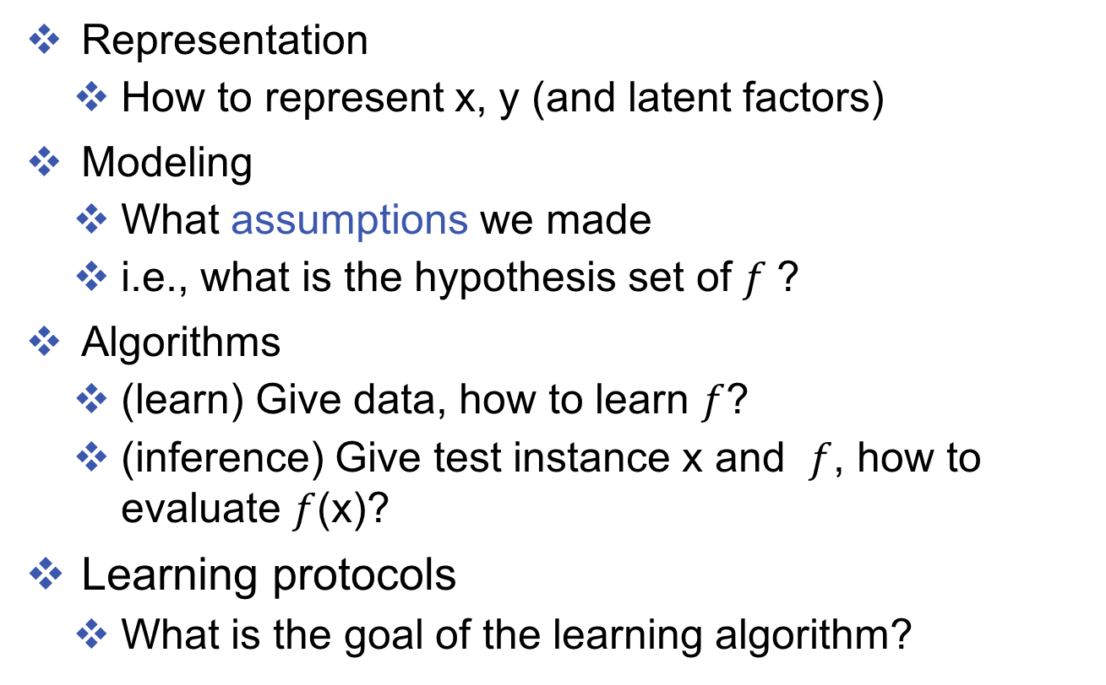
Questions of interest
Representation
How to represent x, y (and latent factors)
Modeling
What assumptions we made
i.e., what is the hypothesis set of $f$?
Algorithms
(learn) Give data, how to learn $f$?
(inference) Give test instance x and $f$, how to evaluate $f$(x)?
Learning protocols
What is the goal of the learning algorithm?

Slide 18
Different learning protocols (more technical terms)
Supervision signals?
Supervised learning, semi-supervised learning, unsupervised learning, bandit feedback
What to be optimized?
Batch learning: minimize the risk (expected average loss)
Online learning: Receive one sample and make prediction Receive the label; then update minimize the accumulated loss

Slide 19

Linear classification

Slide 20
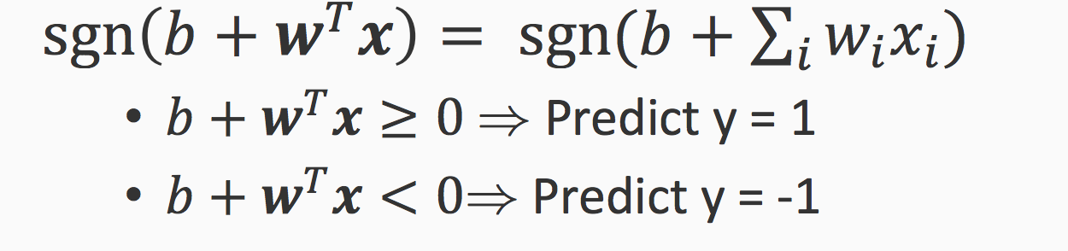
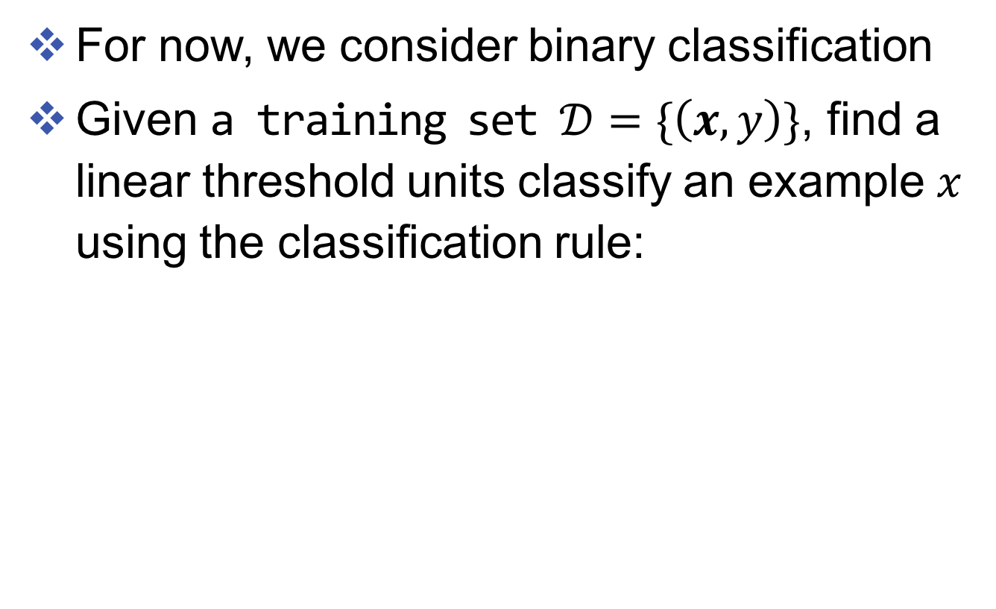
Linear classifiers
For now, we consider binary classification
Given a training set $𝒟=\{\left(x, y\right)\}$, find a linear threshold units classify an example $x$ using the classification rule:
1
2
7
T
3
4
5
6

Slide 21
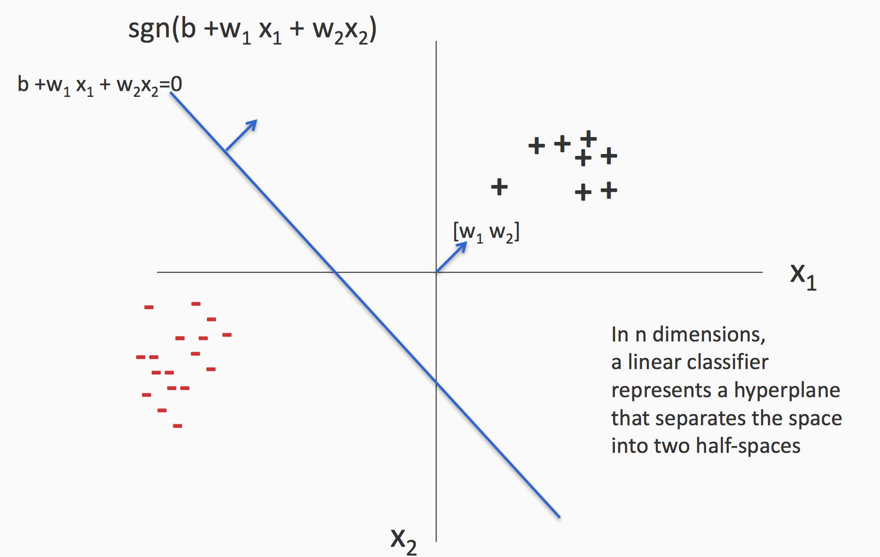
The geometry interpretation

Slide 22
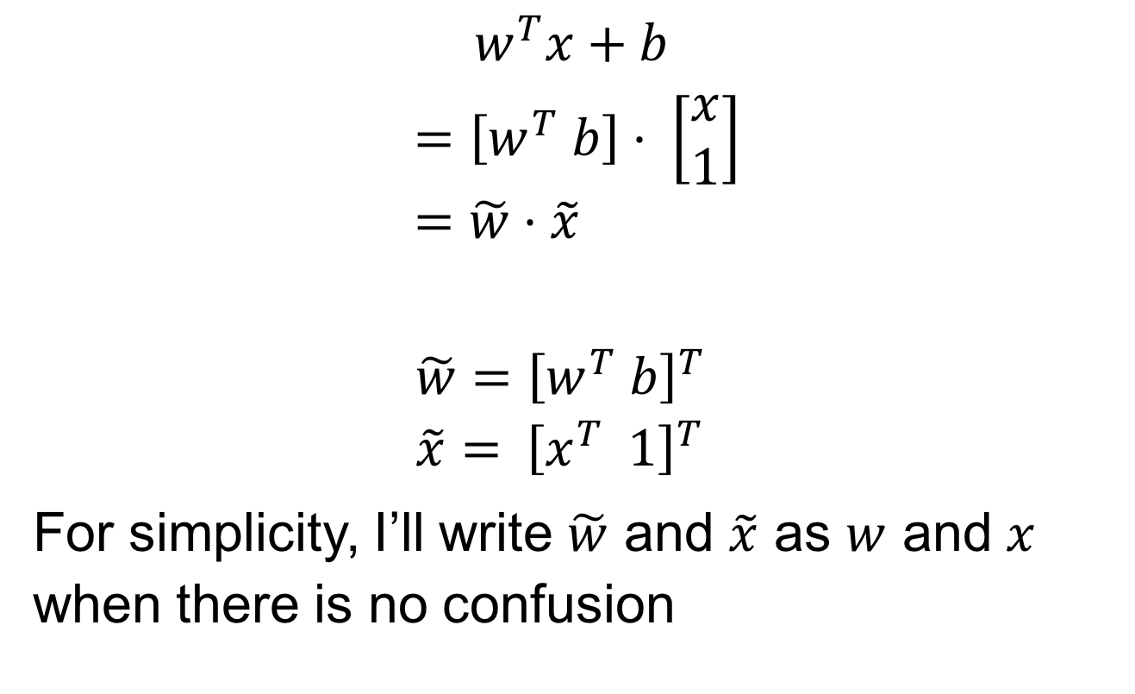
A simple trick to remove the bias term b
$$w^{T}x+b \\ =\left[w^{T} b\right]⋅ \left[\begin{matrix}x \\ 1\end{matrix}\right] \\ =\tilde{w}⋅\tilde{x}$$
$$\tilde{w}={\left[w^{T} b\right]}^{T} \\ \tilde{x}={ \left[x^{T} 1\right]}^{T}$$
For simplicity, I’ll write $\tilde{w}$ and $\tilde{x}$ as $w$ and $x$ when there is no confusion

Slide 23
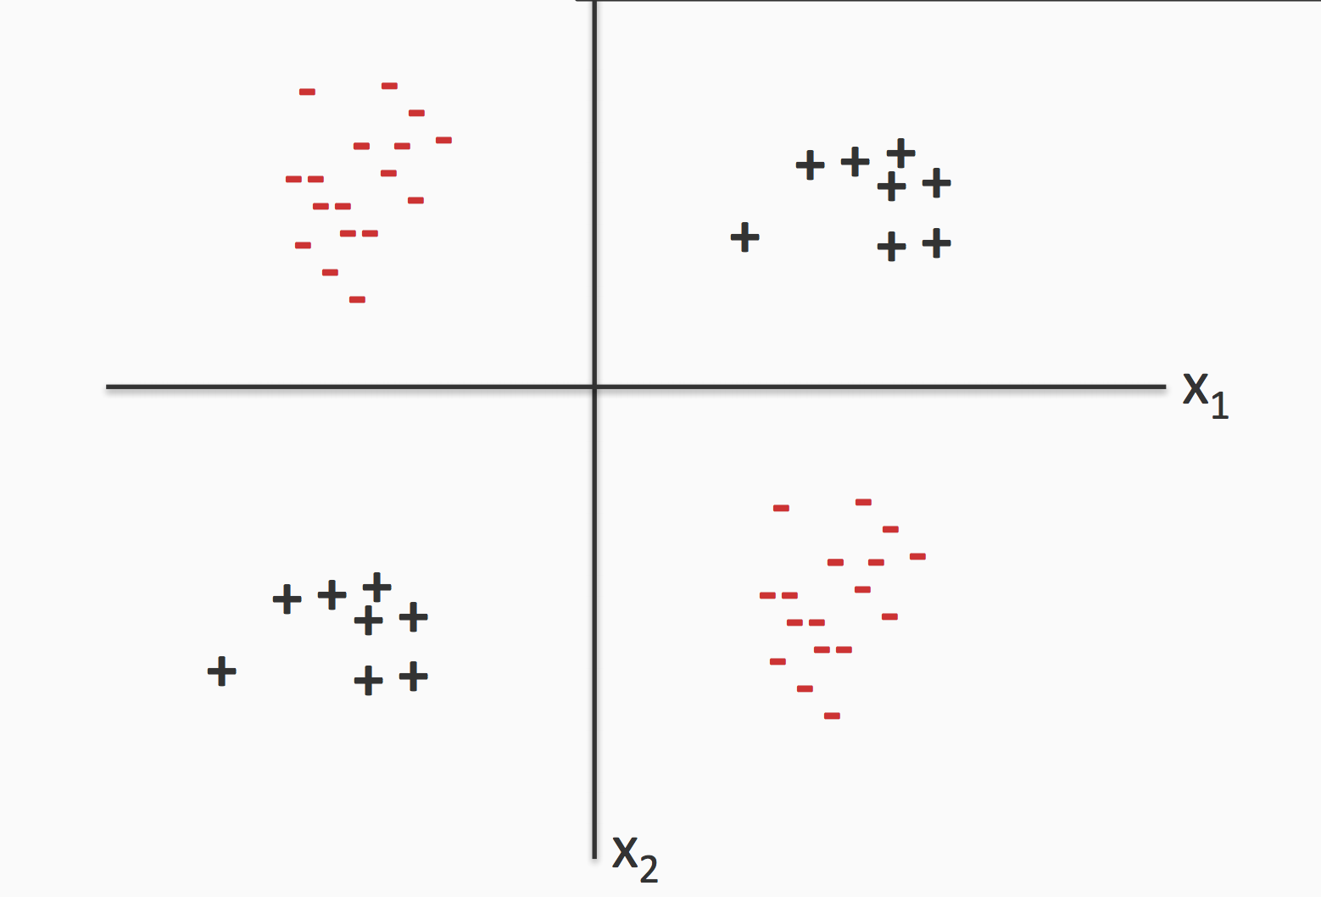
Some data are not linearly separable

Slide 24
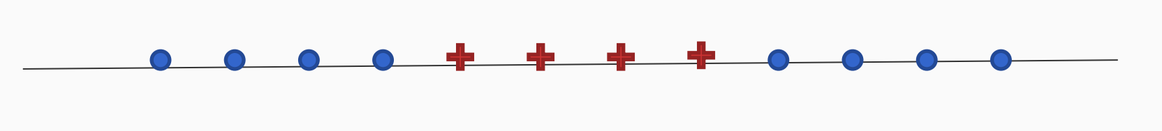
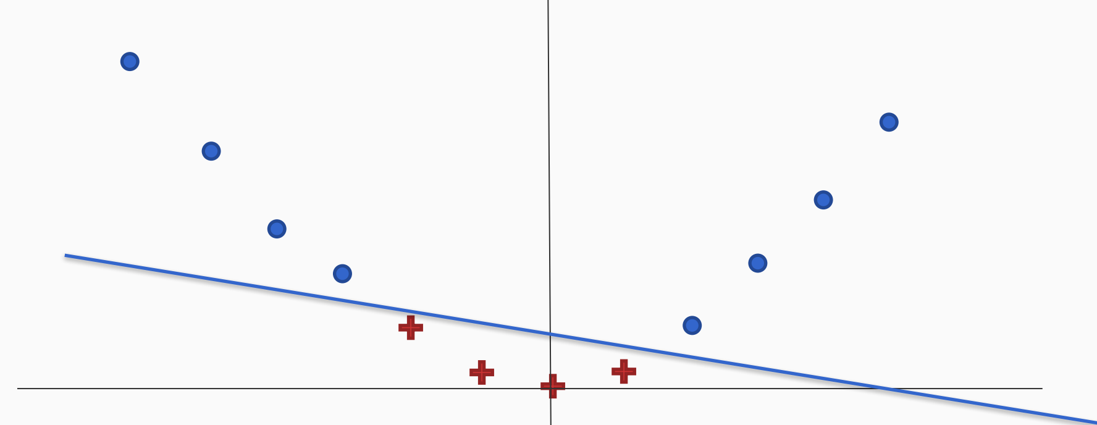
But they can be made liner
Using a different representation
e.g., feature conjunctions, non-linear mapping

Slide 25
Exercise: can you make these data points linearly separable?

Slide 26
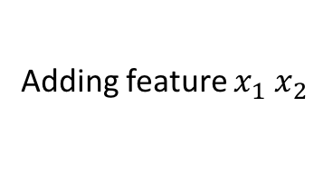
Exercise: can you make these data points linearly separable?
Adding feature $x_{1} x_{2}$

Slide 27
Linear classifiers
Let’s take a look at a few linear classifiers
We will show later, they can be written in the same framework!
Perceptron
(Linear) Support Vector Machines
Logistic Regression

Slide 28
The Perceptron Algorithm [Rosenblatt 1958]
Goal: find a separating hyperplane
Can be used in an online setting: considers one example at a time
Converges if data is separable -- mistake bound

Slide 29
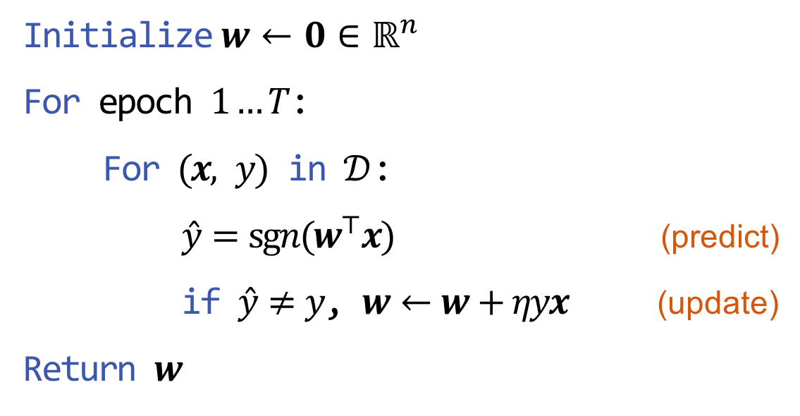
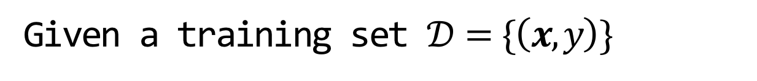

The Perceptron Algorithm [Rosenblatt 1958]
Given a training set $𝒟=\{\left(x, y\right)\}$
Initialize $w←0∈ℝ^{n}$
For epoch $1…T$:
For $(x, y)$ in $𝒟$:
$\hat{y}=\operatorname{sgn}{(w^{⊤}x})$ (predict)
if $\hat{y}≠y$, $w←w+ηyx$ (update)
Return $w$
Learning rate
Prediction: $y^{test}←\operatorname{sgn}{(w^{⊤}x^{test}})$

Slide 30
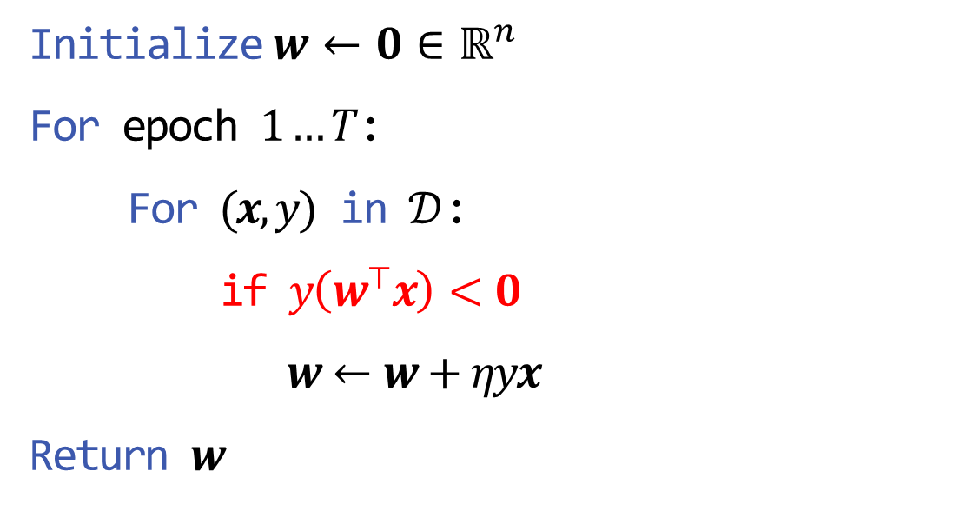
The Perceptron Algorithm [Rosenblatt 1958]
Given a training set $𝒟=\{\left(x, y\right)\}$
Initialize $w←0∈ℝ^{n}$
For epoch $1…T$:
For $(x,y)$ in $𝒟$:
if $y\left(w^{⊤}x\right)<0$
$w←w+ηyx$
Return $w$
Prediction: $y^{test}←\operatorname{sgn}{(w^{⊤}x^{test}})$

Slide 31
Geometry Interpretation
x (with y = +1)
next item to be classified
wx = 0
New decision boundary
x as a vector
wx = 0
Current decision boundary
w Current weight vector
w New weight vector
x as a vector added to w
Weight vector points to the positive side
Positive
(Figures from Bishop 2006)
Negative

Slide 32
Perceptron in action
wx = 0
New decision boundary
x (with y = +1)
next item to be classified
x as a vector
wx = 0
Current decision boundary
w Current weight vector
x as a vector added to w
w New weight vector
Positive
(Figures from Bishop 2006)
Negative

Slide 33
Convergence of Perceptron
Mistake bound
If data is linearly separable (i.e., a good linear model exists), the perceptron will converge after a fixed number of mistakes [Novikoff 1962]

Slide 34
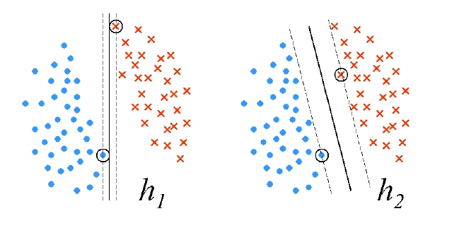
Marginal Perceptron -- Motivation
Which separating hyper-plane is better?
Smaller (

Slide 35
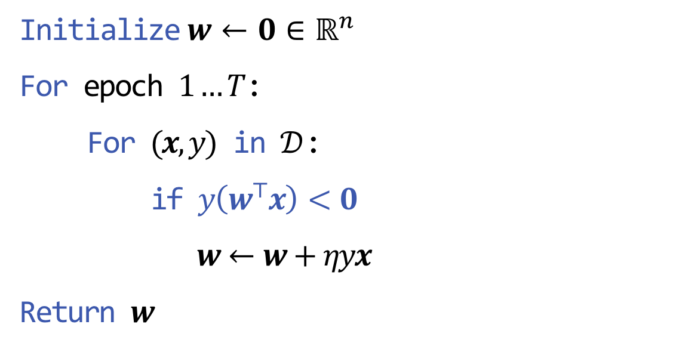
The Perceptron Algorithm [Rosenblatt 1958]
Given a training set $𝒟=\{\left(x, y\right)\}$
Initialize $w←0∈ℝ^{n}$
For epoch $1…T$:
For $(x,y)$ in $𝒟$:
if $y\left(w^{⊤}x\right)<0$
$w←w+ηyx$
Return $w$
Prediction: $y^{test}←\operatorname{sgn}{(w^{⊤}x^{test}})$

Slide 36
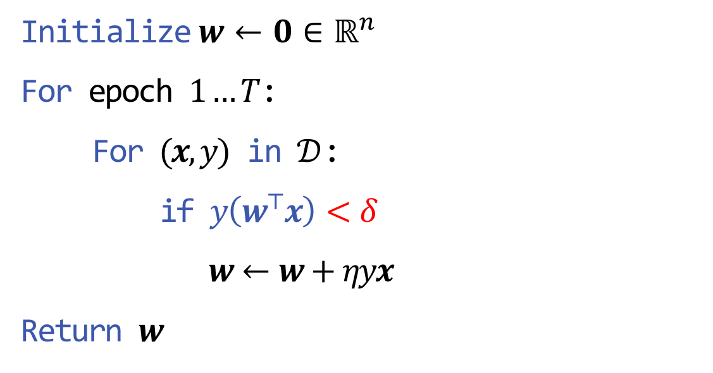
The Perceptron Algorithm [Rosenblatt 1958]
Given a training set $𝒟=\{\left(x, y\right)\}$
Initialize $w←0∈ℝ^{n}$
For epoch $1…T$:
For $(x,y)$ in $𝒟$:
if $y\left(w^{⊤}x\right)<δ$
$w←w+ηyx$
Return $w$
Prediction: $y^{test}←\operatorname{sgn}{(w^{⊤}x^{test}})$

Slide 37
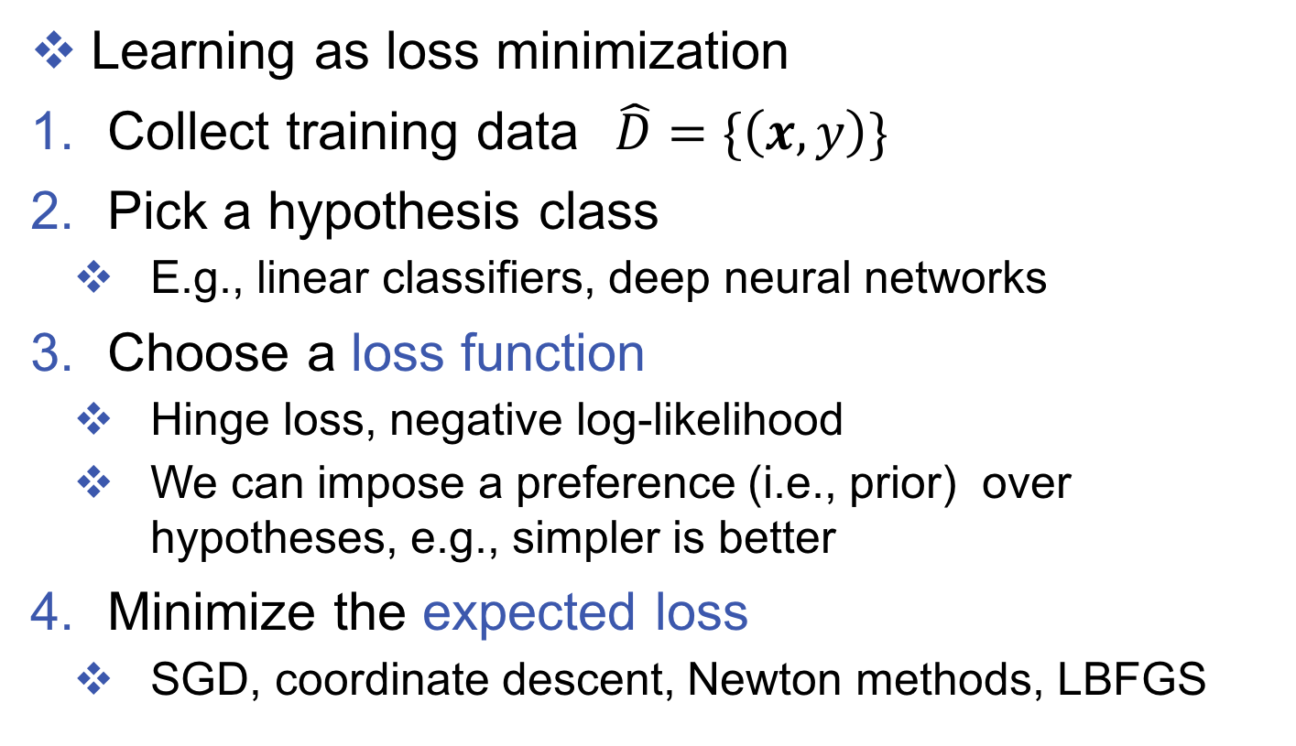
How about batch setting?
Learning as loss minimization
Collect training data$\hat{D}=\{\left(x, y\right)\}$
Pick a hypothesis class
E.g., linear classifiers, deep neural networks
Choose a loss function
Hinge loss, negative log-likelihood
We can impose a preference (i.e., prior) over hypotheses, e.g., simpler is better
Minimize the expected loss
SGD, coordinate descent, Newton methods, LBFGS

Slide 38
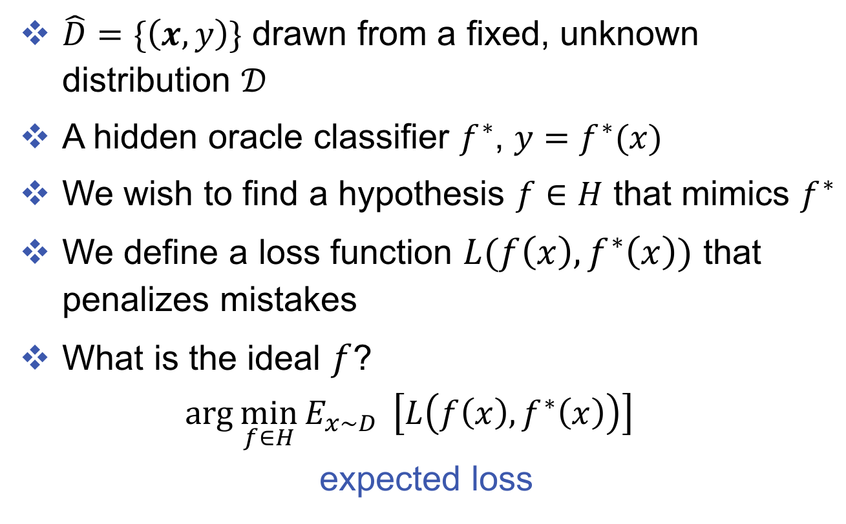
Batch learning setup
$\hat{D}=\{\left(x, y\right)\}$ drawn from a fixed, unknown distribution $𝒟$
A hidden oracle classifier $f^{∗}$, $y=f^{∗}(x)$
We wish to find a hypothesis $f∈H$ that mimics $f^{∗}$
We define a loss function $L(f\left(x\right), f^{∗}\left(x\right))$ that penalizes mistakes
What is the ideal $f$?
$$arg\min_{f∈H}{E_{x\sim D} }\left[L\left(f\left(x\right), f^{∗}\left(x\right)\right)\right]$$ $\text{expected} \text{loss}$

Slide 39
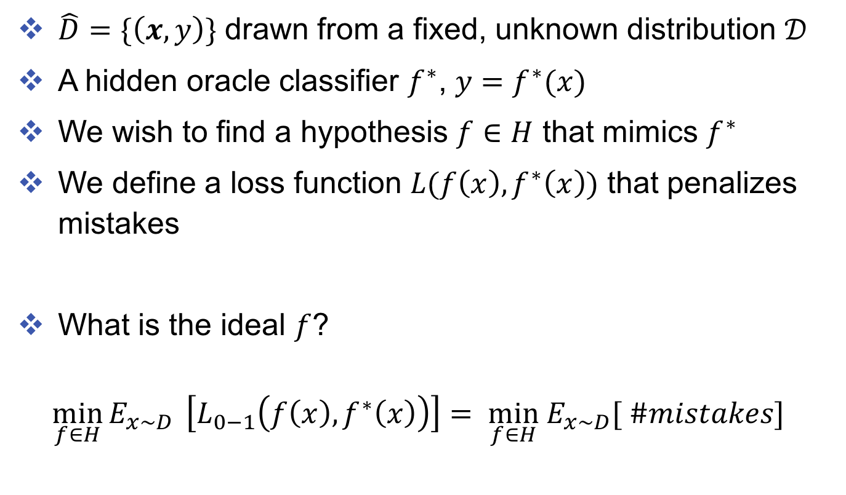
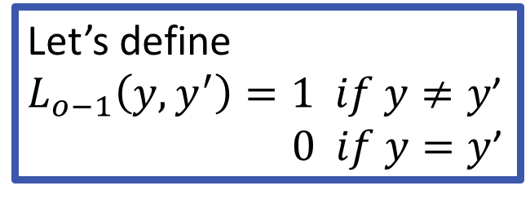
Batch learning setup
$\hat{D}=\{\left(x, y\right)\}$ drawn from a fixed, unknown distribution $𝒟$
A hidden oracle classifier $f^{∗}$, $y=f^{∗}(x)$
We wish to find a hypothesis $f∈H$ that mimics $f^{∗}$
We define a loss function $L(f\left(x\right), f^{∗}\left(x\right))$ that penalizes mistakes
What is the ideal $f$?
$$\min_{f∈H}{E_{x\sim D} }\left[L_{0−1}\left(f\left(x\right), f^{∗}\left(x\right)\right)\right]= \min_{f∈H}{ E}_{x\sim D}[ \#mistakes]$$
Let’s define
$L_{o−1}\left(y, y^{′}\right)=1 if y≠y$’ $0 if y=y$’

Slide 40
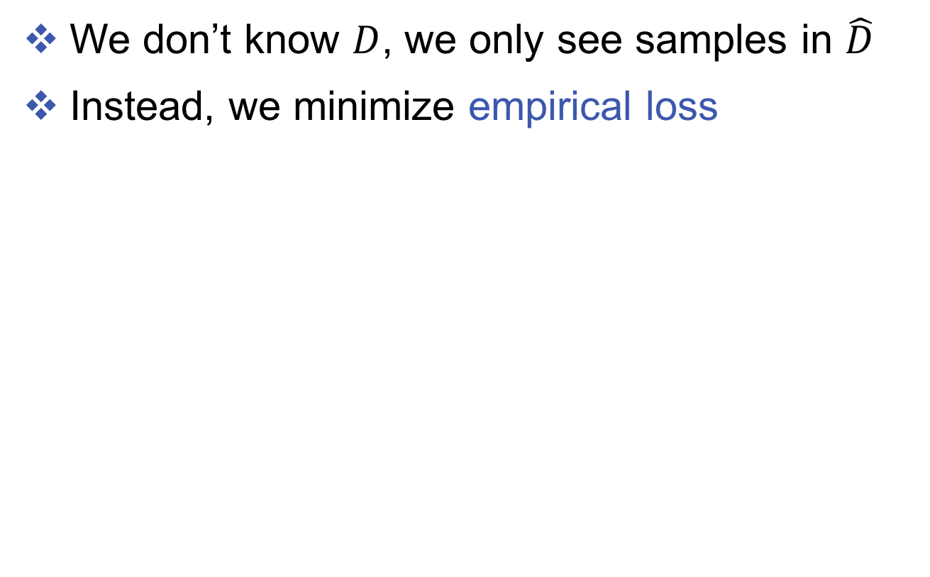
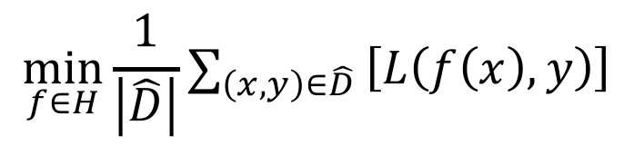
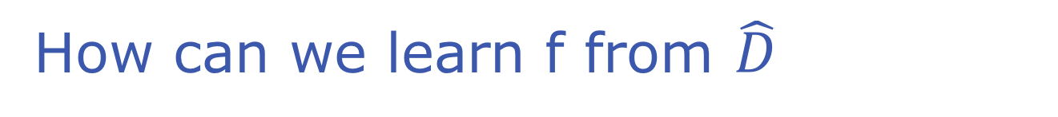
How can we learn f from $\hat{D}$
We don’t know $D$, we only see samples in $\hat{D}$
Instead, we minimize empirical loss
$$\min_{f∈H}{{\frac{1}{\left|\hat{D}\right|}∑}_{\left(x, y\right)∈\hat{D}}}\left[L\left(f\left(x\right), y\right)\right]$$

Slide 41
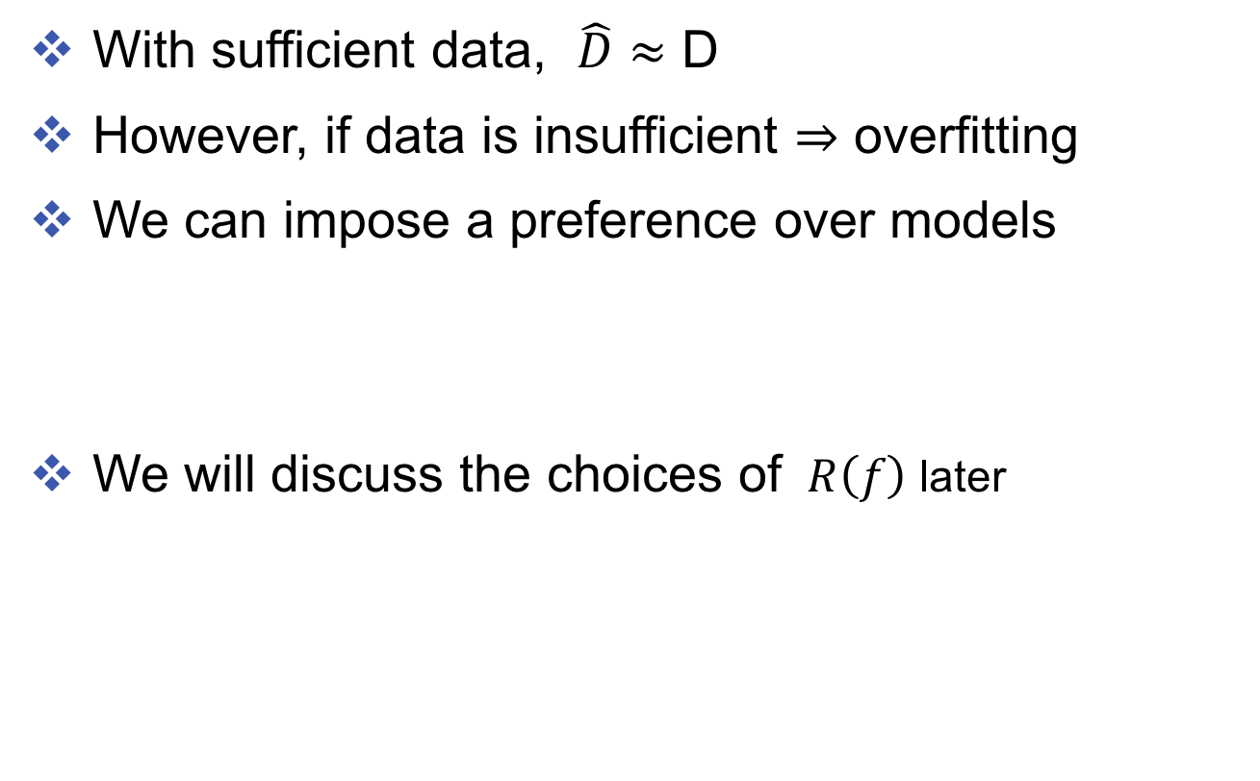
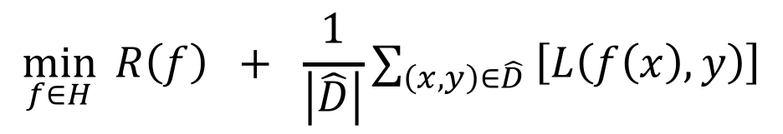
How can we prevent over-fitting?
With sufficient data, $\hat{D}≈$ D
However, if data is insufficient $⇒$ overfitting
We can impose a preference over models
We will discuss the choices of $R\left(f\right)$ later
$$\min_{f∈H}{ R\left(f\right) + {\frac{1}{\left|\hat{D}\right|}∑}_{\left(x, y\right)∈\hat{D}}}\left[L\left(f\left(x\right), y\right)\right]$$

Slide 42
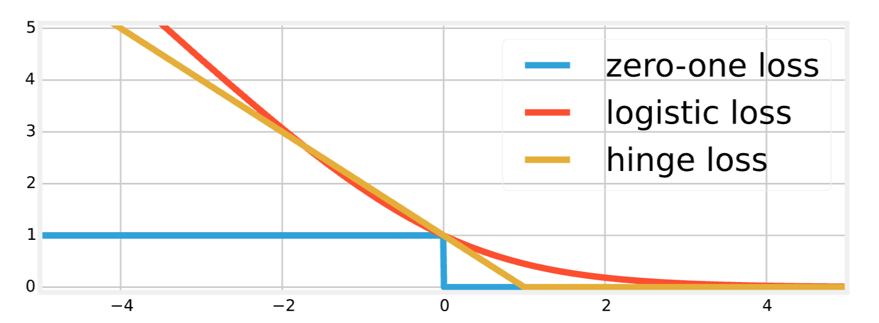
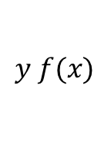
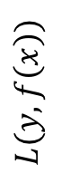
How about the loss function?
Usually, we cannot minimize 0-1 loss
It is a combinatorial optimization problem: NP-hard
Idea: minimizing its upper-bound
$$L(y, f\left(x\right))$$
$$y f(x)$$

Slide 43

How about the loss function?
Usually, we cannot minimize 0-1 loss
It is a combinatorial optimization problem: NP-hard
Idea: minimizing its upper-bound
$$L(y, f\left(x\right))$$
$$y f(x)$$

Slide 44
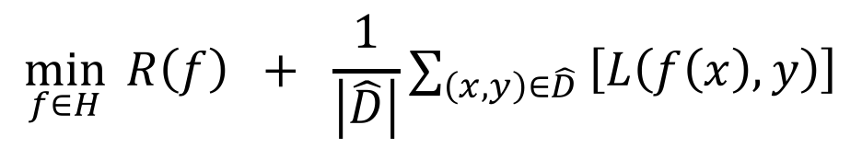
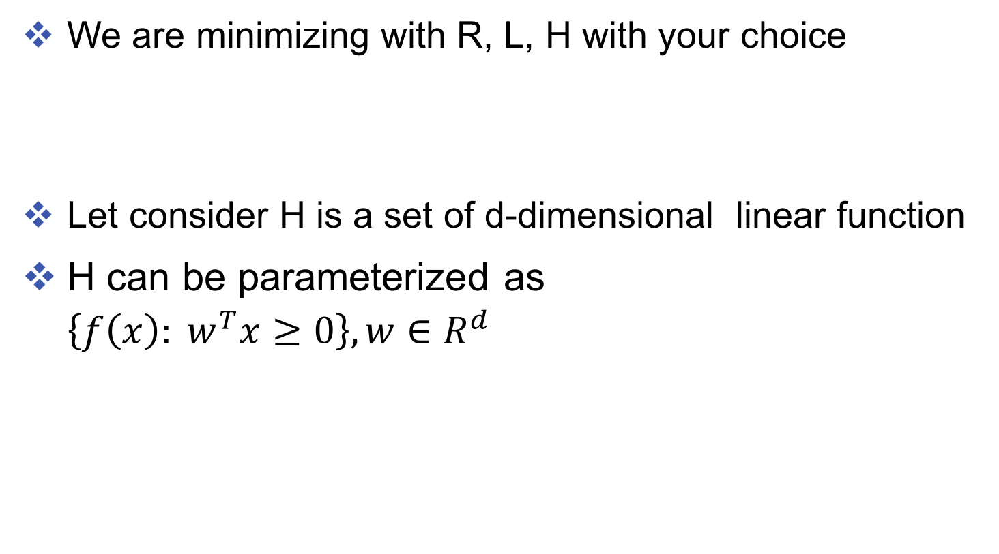
Many choices
We are minimizing with R, L, H with your choice
Let consider H is a set of d-dimensional linear function
H can be parameterized as $\left\{f\left(x\right):{ w}^{T}x≥0\right\}, w∈R^{d}$
$$\min_{f∈H}{ R\left(f\right) + {\frac{1}{\left|\hat{D}\right|}∑}_{\left(x, y\right)∈\hat{D}}}\left[L\left(f\left(x\right), y\right)\right]$$

Slide 45
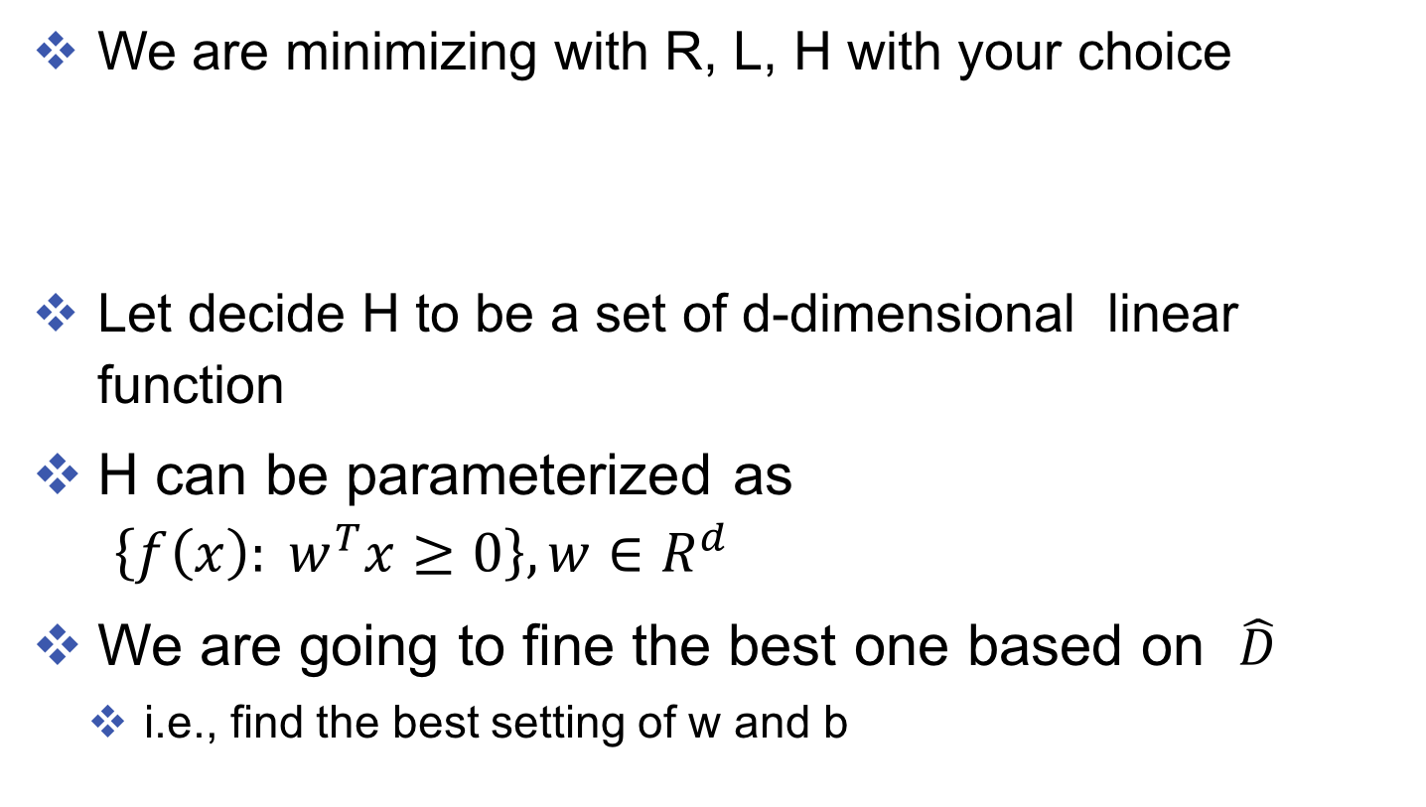
Back to Linear model
We are minimizing with R, L, H with your choice
Let decide H to be a set of d-dimensional linear function
H can be parameterized as $\left\{f\left(x\right):{ w}^{T}x≥0\right\}, w∈R^{d}$
We are going to fine the best one based on $\hat{D}$
i.e., find the best setting of w and b
$$\min_{f∈H}{ R\left(f\right) + {\frac{1}{\left|\hat{D}\right|}∑}_{\left(x, y\right)∈\hat{D}}}\left[L\left(f\left(x\right), y\right)\right]$$

Slide 46
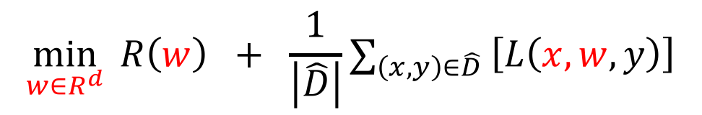
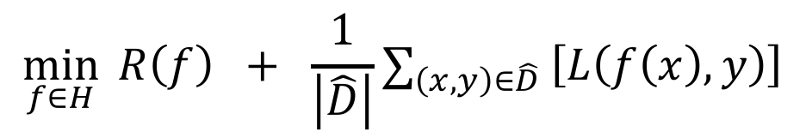
Rewrite our optimization problem
Minimizing the empirical loss:
Minimizing the empirical loss with linear function
What choices of R and L we have?
$$\min_{f∈H}{ R\left(f\right) + {\frac{1}{\left|\hat{D}\right|}∑}_{\left(x, y\right)∈\hat{D}}}\left[L\left(f\left(x\right), y\right)\right]$$
$$\min_{w∈R^{d}}{ R\left(w\right) + {\frac{1}{\left|\hat{D}\right|}∑}_{\left(x, y\right)∈\hat{D}}}\left[L\left(x,w, y\right)\right]$$

Slide 47
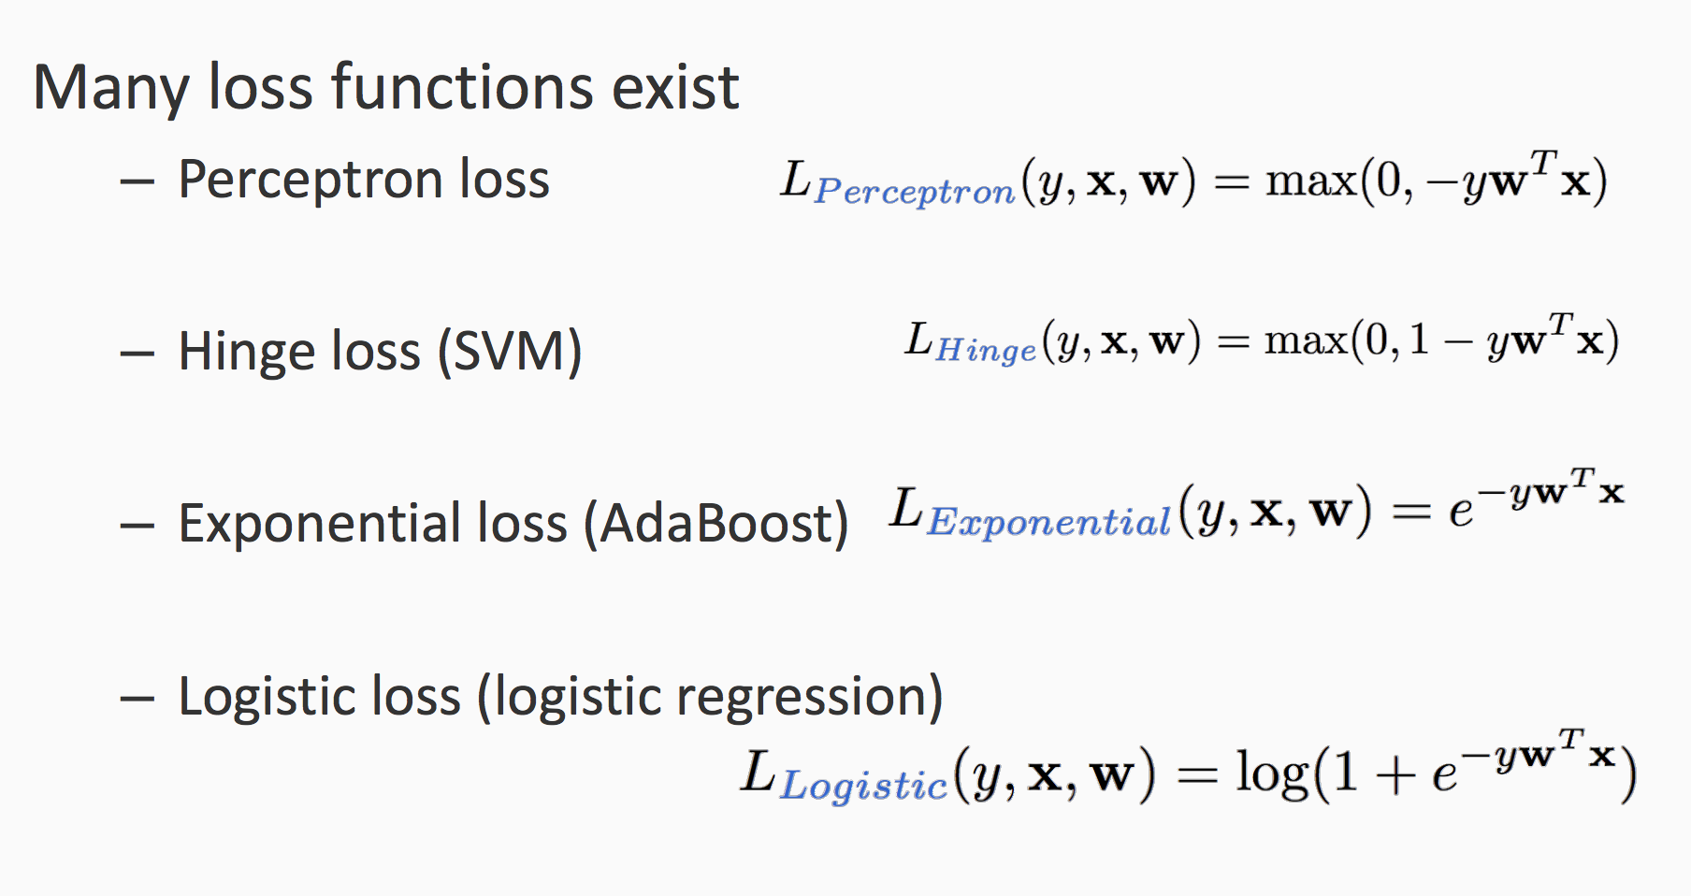
Many choices of loss function (L)

Slide 48
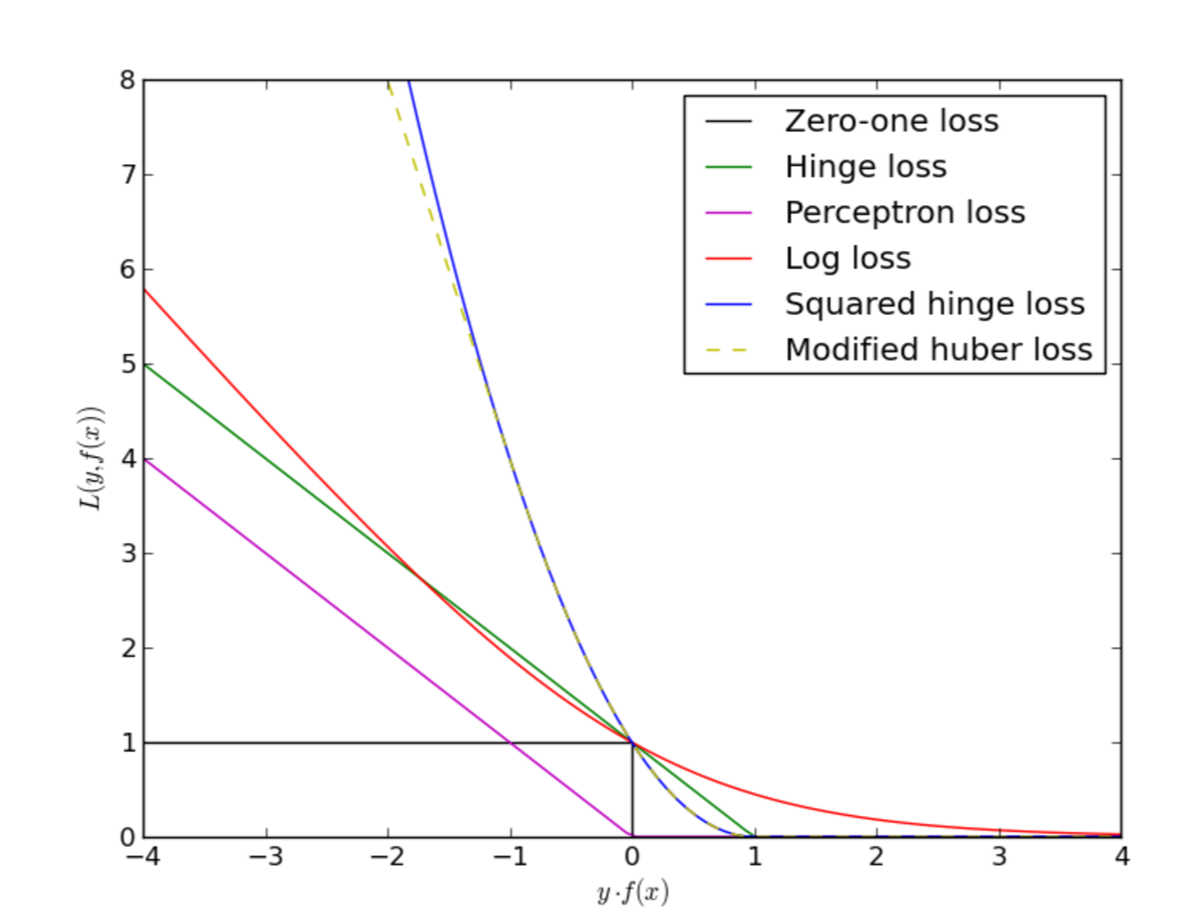

Slide 49
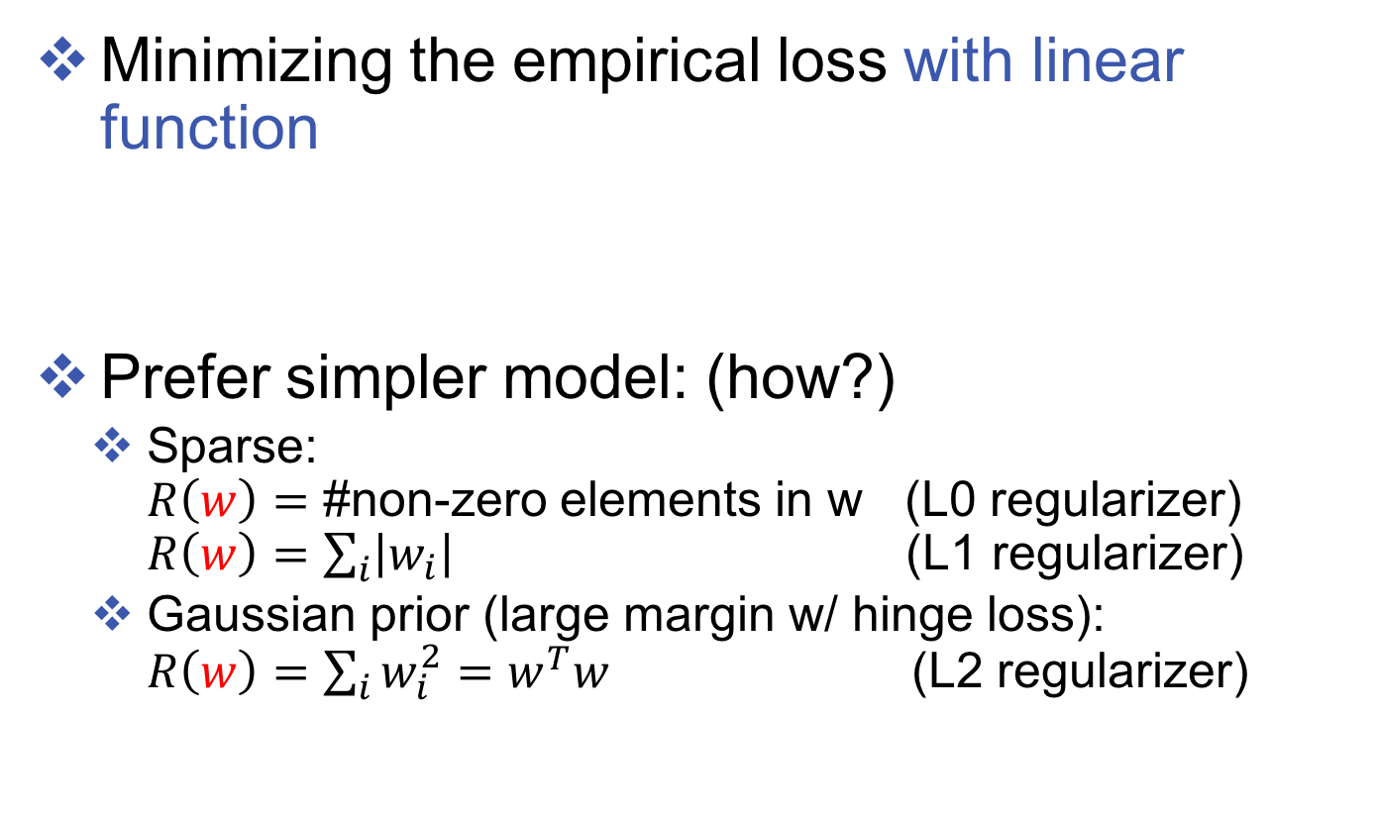

Many choices of R(w)
Minimizing the empirical loss with linear function
Prefer simpler model: (how?)
Sparse: $R\left(w\right)=$ #non-zero elements in w (L0 regularizer) $R\left(w\right)=\sum_{i}{\left|w_{i}\right|}$ (L1 regularizer)
Gaussian prior (large margin w/ hinge loss): $R\left(w\right)=\sum_{i}{w_{i}^{2}}=w^{T}w$ (L2 regularizer)
$$\min_{w∈R^{d}}{ R\left(w\right) + {\frac{1}{\left|\hat{D}\right|}∑}_{\left(x, y\right)∈\hat{D}}}\left[L\left(x,w, y\right)\right]$$

Slide 50
Support Vector Machines
CMU ML protest

Slide 51
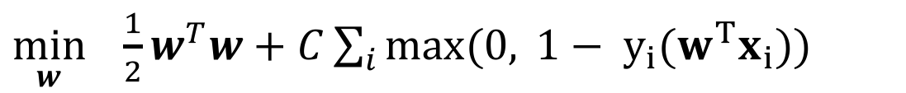
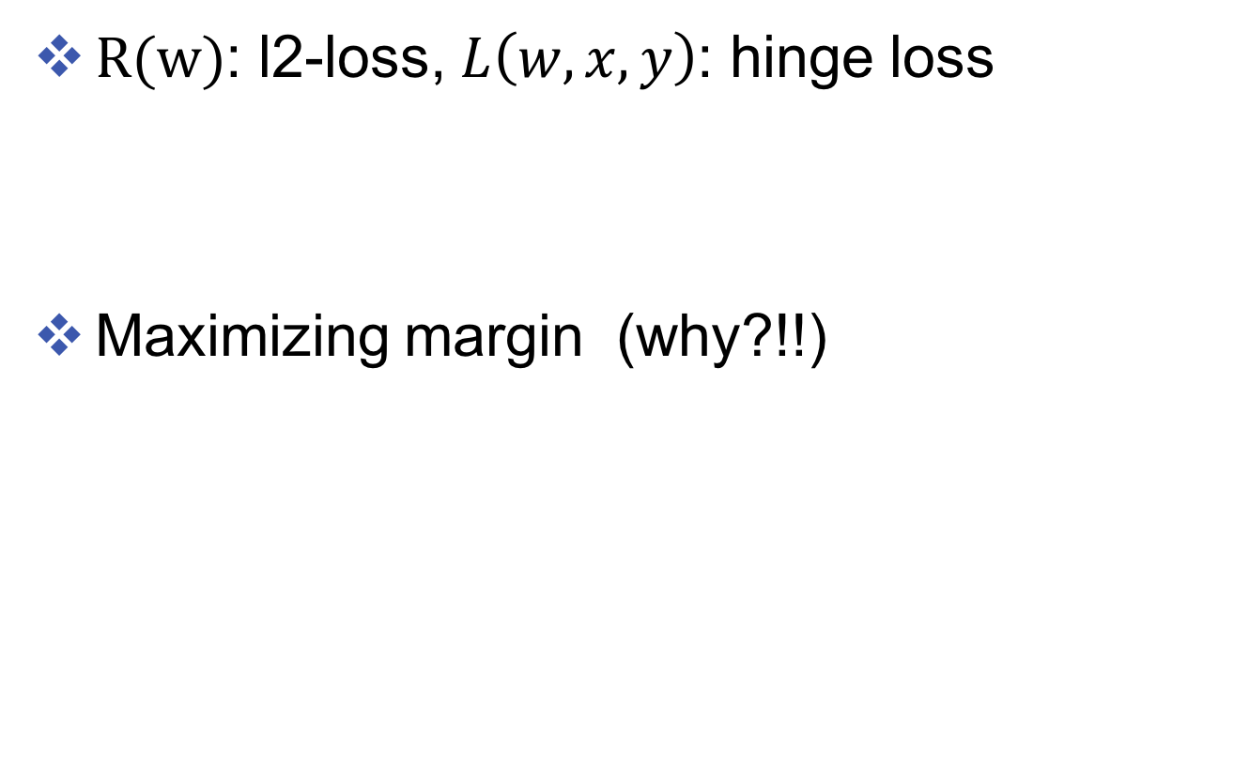
Support Vector Machines (SVMs)
$R(w)$: l2-loss, $L\left(w,x,y\right)$: hinge loss
Maximizing margin (why?!!)
$\min_{w} \frac{1}{2}w^{T}w+C\sum_{i}{\max{(0, }1− y_{i}{(w}^{T}x_{i}))}$

Slide 52
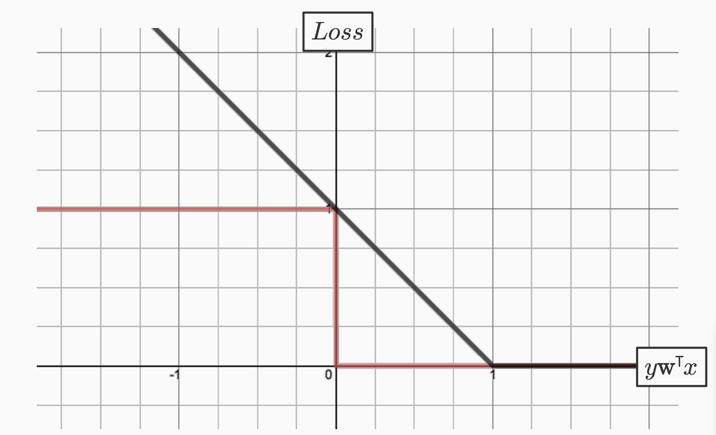
The hinge loss

Slide 53
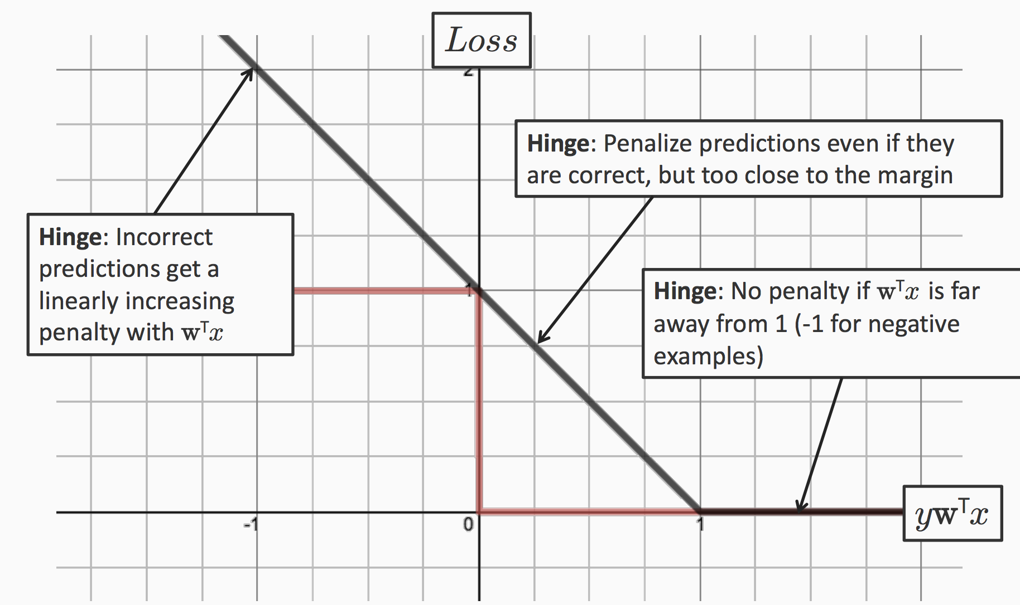

Slide 54
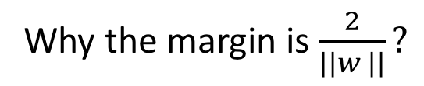
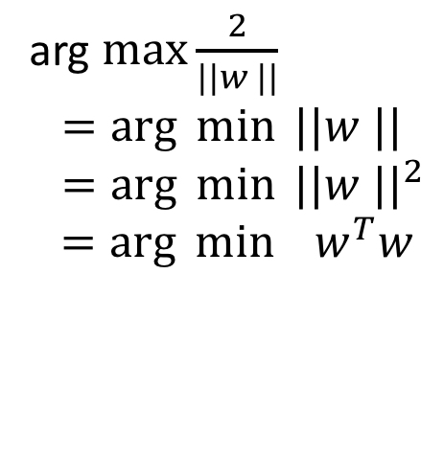
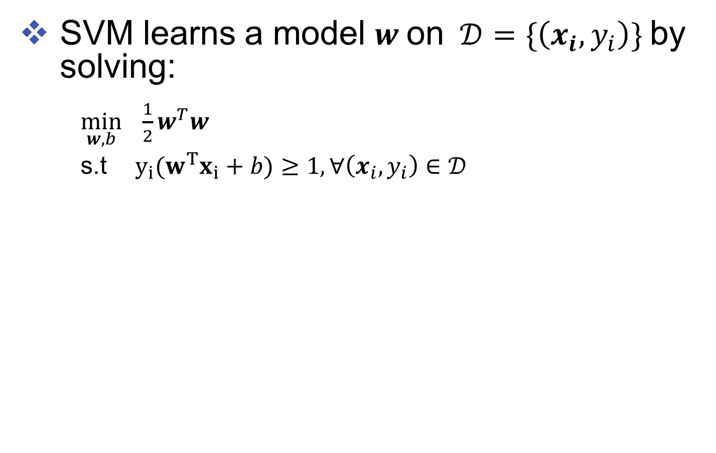
Let’s view it from another direction
SVM learns a model $w$ on $𝒟=\{\left(x_{i}, y_{i}\right)\}$ by solving:
$\min_{w,b} \frac{1}{2}w^{T}w$ s.t $y_{i}{(w}^{T}x_{i}+b)≥1, ∀\left(x_{i},y_{i}\right)∈𝒟$
(Hard SVM)
Why the margin is $\frac{2}{||w ||}?$
arg $\max{\frac{2}{||w ||}}$ $=\arg{\min{||w ||}}$
$=\arg{\min{||w ||^{2}}}$
$=\arg{\min{ w^{T}w}}$

Slide 55
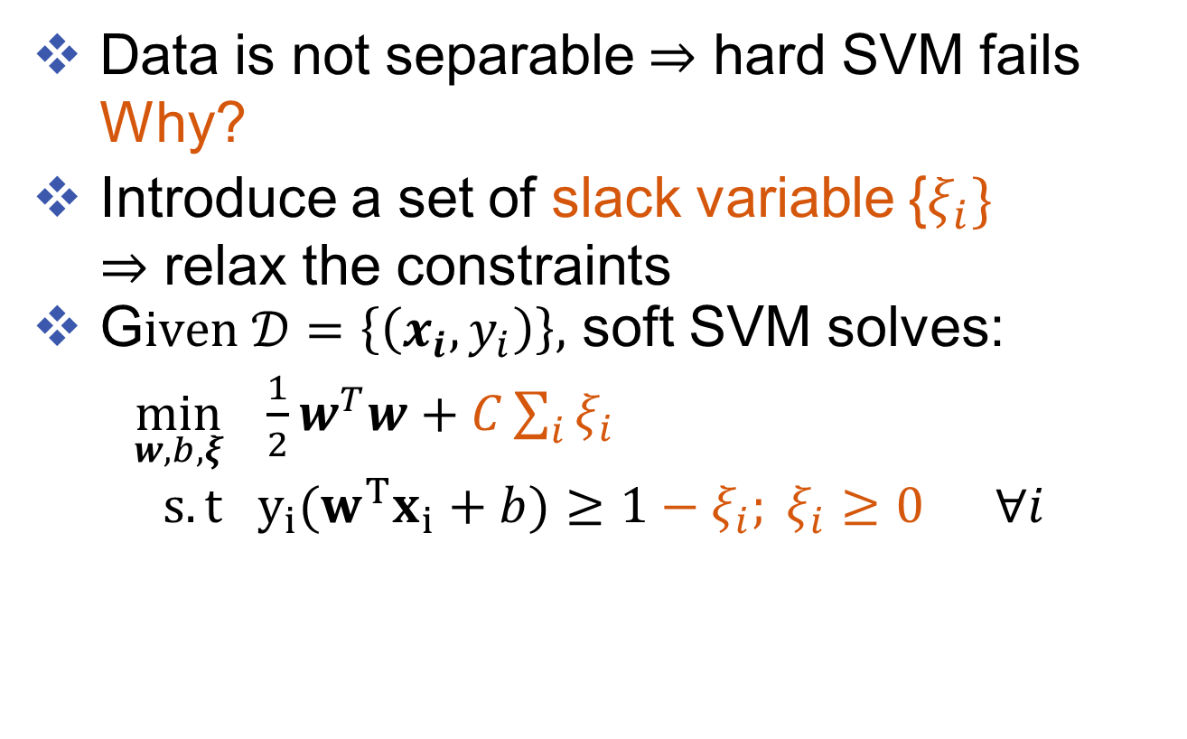
Soft SVMs
Data is not separable $⇒$ hard SVM fails Why?
Introduce a set of slack variable {$ξ_{i}\}$ $⇒$ relax the constraints
G$iven 𝒟=\left\{\left(x_{i}, y_{i}\right)\right\},$ soft SVM solves:
$\min_{w,b, ξ} \frac{1}{2}w^{T}w+C\sum_{i}{ξ_{i}}$ $s.t y_{i}{(w}^{T}x_{i}+b)≥1−ξ_{i}; ξ_{i}≥0 ∀i$
(Soft SVM)
penalty parameter

Slide 56

An alternative formulation
$\min_{w,b, ξ} \frac{1}{2}w^{T}w+C\sum_{i}{ξ_{i}}$ $s.t y_{i}{(w}^{T}x_{i}+b)≥1−ξ_{i}; ξ_{i}≥0 ∀i$
Rewrite the constraints:
$ξ_{i}≥1− y_{i}{(w}^{T}x_{i}+b); ξ_{i}≥0$ $∀i$
In the optimum, $ξ_{i}=\max{(0, }1− y_{i}{(w}^{T}x_{i}+b))$
Soft SVM can be rewritten as: $\min_{w,b} \frac{1}{2}w^{T}w+C\sum_{i}{\max{(0, }1− y_{i}{(w}^{T}x_{i}+b))}$
Regularization term
Empirical loss

Slide 57
An alternative formulation
$\min_{w,b, ξ} \frac{1}{2}w^{T}w+C\sum_{i}{ξ_{i}}$ $s.t y_{i}{(w}^{T}x_{i}+b)≥1−ξ_{i}; ξ_{i}≥0 ∀i$
Rewrite the constraints:
$ξ_{i}≥1− y_{i}{(w}^{T}x_{i}+b); ξ_{i}≥0$ $∀i$
In the optimum, $ξ_{i}=\max{(0, }1− y_{i}{(w}^{T}x_{i}+b))$
Soft SVM can be rewritten as: $\min_{w,b} \frac{1}{2}w^{T}w+C\sum_{i}{\max{(0, }1− y_{i}{(w}^{T}x_{i}+b))}$
We can simply ”b” using the trick
However, we will add b into the regularization term
It is often okay, if we have many features
Regularization term
Empirical loss

Slide 58
Balance between regularization and empirical loss

Slide 59
Balance between regularization and empirical loss
(DEMO)

Slide 60

Regularized loss minimization
L1-Loss SVM
$\min_{w} \frac{1}{2}w^{T}w+C\sum_{i}{\max{(0, }1− y_{i}{(w}^{T}x_{i}))}$
L2-Loss SVM $\min_{w} \frac{1}{2}w^{T}w+C\sum_{i}{{\max{(0,1− y_{i}{(w}^{T}x_{i}))}}^{2}}$
Logistic Regression (regularized)
$\min_{w} \frac{1}{2}w^{T}w+C\sum_{i}{\log{(}1+e^{−y_{i}{(w}^{T}x_{i})})}$
Loss over training data + regularizer

Slide 61

Loss Functions

Slide 62

Logistic Regression
Regression Logistic regression
Logistic function

Slide 63


logistic function / sigmoid function
When $z→∞$ what is $σ\left(z\right)?$
When $z→−∞$ what is $σ\left(z\right)?$
When $z=0$ what is $σ\left(z\right)?$

Slide 64


Why sigmoid?

Slide 65


Probabilistic Interpretation
$$\min_{w} \frac{1}{2}w^{T}w+C\sum_{i}{\log{(}1+e^{−y_{i}{(w}^{T}x_{i})})}$$
Assume labels are generated using the following probability distribution:

Slide 66

How to make prediction?
Predict y=1 if P(y=1|x,w ) > p (y= -1|x, w)

Slide 67


Decision boundary?
The decision boundary?

Slide 68


Alternative view
Predict y=1 if P(y=1|x,w ) > P(y= -1|x, w)
When does this happen?
$\frac{1}{1+exp⁡(−w^{T}x)}>0.5$ $⇒1+\exp\left(−w^{T}x\right)<2$ $⇒\exp\left(−w^{T}x\right)<1$ $⇒w^{T}x>0$

Slide 69


Maximum likelihood estimation
Probabilistic model assumption:
The log-likelihood of seeing a dataset D = {(x , y )} if the true weight vector was w:
$$P\left(D | w\right)=Π_{i} P\left(y_{i} | x_{i}, w\right)$$
$$⇒\log{P\left(D | w\right)}=∑_{i}\log{P\left(y_{i} | x_{i}, w\right) }$$

Slide 70


Minimizing negative log-likelihood
Log likelihood
Logistic regression
Let’s add some prior
Simpler is better $⇒$ add Gaussian Prior
$\min_{w,b} \sum_{i}{\log{(}1+e^{−y_{i}{(w}^{T}x_{i})})}$

Slide 71



Add Gaussian Prior
Simpler is better $⇒$ add Gaussian Prior
Suppose each element in w is drawn independently from the normal distribution centered at zero with variance $σ^{2}$
Bias towards smaller weights

Slide 72


Regularized Logistic regression
Remember we are in the log space
Put them together
$P\left(w | D\right) ∝P\left(w, D\right)=P\left(D | w\right)P(w)$
Learning: Find weight vector by maximizing the posterior distribution P(w | D)

Slide 73



Maximum a posteriori estimation
Put them together
$P\left(w | D\right) ∝P\left(w, D\right)=P\left(D | w\right)P(w)$
Learning: Find weight vector by maximizing the posterior distribution P(w | D)
prior
Log-likelihood
$$\min_{w} \frac{1}{2}w^{T}w+C\sum_{i}{\log{(}1+e^{−y_{i}{(w}^{T}x_{i})})}$$

Slide 74
Regularized loss minimization
L1-Loss SVM
$\min_{w} \frac{1}{2}w^{T}w+C\sum_{i}{\max{(0, }1− y_{i}{(w}^{T}x_{i}))}$
L2-Loss SVM $\min_{w} \frac{1}{2}w^{T}w+C\sum_{i}{{\max{(0,1− y_{i}{(w}^{T}x_{i}))}}^{2}}$
Logistic Regression (regularized)
$\min_{w} \frac{1}{2}w^{T}w+C\sum_{i}{\log{(}1+e^{−y_{i}{(w}^{T}x_{i})})}$
Loss over training data + regularizer

Slide 75

How to learn (how to optimize the objective function?)
$\min_{w} \frac{1}{2}w^{T}w+C\sum_{i}{\max{(0, }1− y_{i}{(w}^{T}x_{i}))}$
This function is convex
Many convex optimization methods can be used
Stochastic (sub)-gradient descent
Coordinate descent methods
Newton methods
LBFGS

Slide 76

Convexity

Slide 77

Non convex minimization is hard
You may end up with some local minimum

Slide 78

Convex optimization is relatively easy
Ensure that there are no local minima
Note: need special design for functions that are not differentiable (e.g., hinge loss)

Slide 79

Different optimization techniques
Some methods (e.g., SGD, CD) are fast in the early stage of optimization
Some methods (e.g., Newton methods) converge faster
Results from http://www.cs.virginia.edu/~kc2wc/papers/ChangHsLi08.pdf

Slide 80

Gradient descent

Slide 81





Why not gradient descent?
For some functions, gradient may not exist
Solution: use sub-gradient
$\min_{w} \frac{1}{2}w^{T}w+C\sum_{i}{\max{(0, }1− y_{i}{(w}^{T}x_{i}))}$
$$C^{′}=\left|D\right|×C$$
$f\left(w\right)= \frac{1}{2}w^{T}w+C\sum_{i}{\max{(0, }1− y_{i}w^{T}x_{i})}$
$= \frac{1}{|D|} \sum_{i}{(\frac{ 1}{2}w^{T}w+C′\max{(0, }1− y_{i}w^{T}x_{i})})$
$≡\frac{1}{\left|D\right|}\sum_{i}{f_{i}\left(w\right)}$ $∇f\left(w\right)=\frac{1}{|D|}\sum_{i}{{∇f}_{i}(w)}$
$$∇f_{i}\left(w\right)≡\left\{\begin{matrix}w if y_{i}{(w}^{T}x_{i})>1 \\ w−C′y_{i}x_{i} otherwise \end{matrix}, \right.$$

Slide 82


Stochastic gradient descent
$f\left(w\right)= \frac{1}{2}w^{T}w+C\sum_{i}{\max{(0, }1− y_{i}w^{T}x_{i})}$
$= \frac{1}{|D|} \sum_{i}{(\frac{ 1}{2}w^{T}w+C′\max{(0, }1− y_{i}w^{T}x_{i})})$
$≡ f_{i}\left(w\right)$ $∇f\left(w\right)=\frac{1}{|D|}\sum_{i}{{∇f}_{i}(w)}=E_{i\sim D}∇f_{i}(w)$
Approximate the true gradient by a gradient at a single example at a time
Repeat until converge:
Randomly pick one sample $(x_{i},y_{i})$
Update $w←w−η∇f_{i}(w)$

Slide 83


Stochastic Sub-gradient Descent
Given a training set $𝒟=\{\left(x, y\right)\}$
Initialize $w←0∈ℝ^{n}$
For epoch $1…T$:
For $(x,y)$ in $𝒟$:
Update $w←w−η ∇ f(w)$
Return $w$
$f\left(w\right)≡ \frac{1}{2}w^{T}w+C\sum_{i}{\max{(0, }1− y_{i}{(w}^{T}x_{i}))}$

Slide 84

Stochastic (sub)-gradient descent for SVM
Given a training set $𝒟=\{\left(x, y\right)\}$
Initialize $w←0∈ℝ^{n}$
For epoch $1…T$:
For $(x,y)$ in $𝒟$:
if $y\left(w^{⊤}x\right)<1$
$w←\left(1−η\right)w+η C yx$
else
$w←\left(1−η\right)w$
Return $w$

Slide 85
The Perceptron Algorithm [Rosenblatt 1958]
Given a training set $𝒟=\{\left(x, y\right)\}$
Initialize $w←0∈ℝ^{n}$
For epoch $1…T$:
For $(x,y)$ in $𝒟$:
if $y\left(w^{⊤}x\right)<0$
$w←w+ηyx$
Return $w$
Prediction: $y^{test}←\operatorname{sgn}{(w^{⊤}x^{test}})$

Slide 86

The Perceptron Algorithm [Rosenblatt 1958]
Given a training set $𝒟=\{\left(x, y\right)\}$
Initialize $w←0∈ℝ^{n}$
For epoch $1…T$:
For $(x,y)$ in $𝒟$:
if $y\left(w^{⊤}x\right)<0$
$w←w+ηyx$
Return $w$
Perceptron effectively minimizing:
$$\sum_{i}{\max{(0, }1− y_{i}{(w}^{T}x_{i}))}$$
Prediction: $y^{test}←\operatorname{sgn}{(w^{⊤}x^{test}})$

Slide 87

A General Formula
$\hat{y}={argmax}_{y∈𝒴}{f(y;w,x)}$
Inference/Test: given $w,x$, solve $argmax$
Learning/Training: find a good $w$
Today: $x∈ℝ^{n},𝒴=\{−1,1\}$ (binary classification)
input
model parameters
output space

Slide 88

Binary Linear Classifiers
$\hat{y}={argmax}_{y∈𝒴}{f(y;w,x)}$
$x∈ℝ^{n},𝒴=\{−1,1\}$
$f\left(y;w,x\right)≝y\left(w^{⊤}x+b\right)=y\left(\sum_{i}{w_{i}x_{i}}+b\right)$
${argmax}_{y∈𝒴}{f(y;w,x)}$ $=\left\{\begin{aligned} 1,w^{⊤}x+b≥0 \\ &−1,w^{⊤}x+b<0\end{aligned}\right.$ $=sgn\left(w^{⊤}x+b\right)$
(break ties arbitrarily)

